Slide 1
Introduction to Spread Spectrum
Introduction
Application
Need
Significance
Block Diagram
Types
By Jasleen Kaur
IT Dept.

Slide 2
Problems encountered by a communication system :
In area such as military the information has to be secured and should not be allowed to interfere communication by any means.
Sometimes a hostile transmitter can jam transmission. To avoid this the channel should be immune to any external interference.
Even in non military communications an unintentional interference is caused by a user who is transmitting its information through a channel which is already being used.
These problems can be solved using a technique called spread spectrum.

Slide 3
Spread Spectrum
It is modulation technique in which transmitted BN is larger then information signal BN.
Bit rate of spreading sequence is much larger than the input data.
SS signal occupies a larger bandwidth than that of normal signal .
Problem such as capacity limits, propagation effects, synchronization occur with wireless systems.
Spread Spectrum modulation spreads out the modulated signal bandwidth so it is much greater than the message bandwidth.

Slide 4
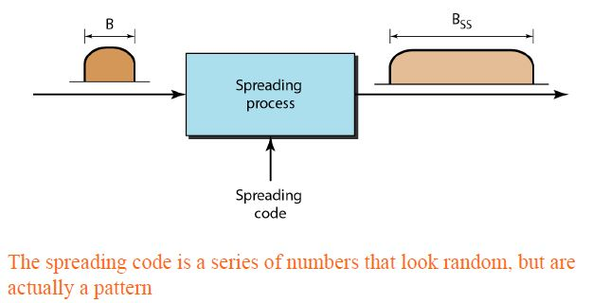
Bss>>B (BSS: Spreading Bandwidth, B:Bandwidth of signal)
BSS=LB ;
Processing Gain or Spreading Factor; L= BSS/B {for Analog System}
L=Tb/Tc (Tb:bit time period , Tc: chip time period) {for Digital System}

Slide 5
Application of SS Modulation Technique:
In combating the intentional interference (jamming)
In rejecting the unintentional interference from some other user.
To avoid the self interference due to multipath propagation.
In obtaining the message privacy.
Need of Spread Spectrum :
Improves the limitation of FDMA and TDMA which are:
Limited bandwidth , it require high spectral efficiency
Due to limited bandwidth , Concentrated Spectrum
Due to limited bandwidth , Narrowband Spectrum

Slide 6
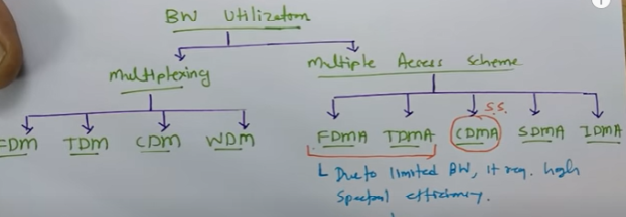

Slide 7
Significance of Spread Spectrum
Immunity to jamming
Low Interference
High Processing Gain
Easy Encryption
Greater Security
Multiple Access

Slide 8
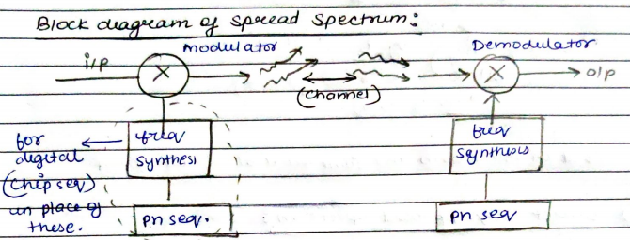
A pseudo-noise (PN) sequence may be defined as a coded sequence of 1s & 0s with certain auto-correlation properties.
These Additional frequency from frequency synthesisers is transmitted with the input data based on the data in PN sequence to spread the spectrum of data and reverse happens at the reception end.

Slide 9
There are two types of spread spectrum systems:
Frequency Hopping Spread Spectrum (FH-SS): In this, the data is used to modulate carrier. The data modulated carrier is then randomly hoped from one frequency to the other. Because of this , spectrum of transmitted signal is spreaded sequentially rather than instantaneously.
Uses MFSK (M-ary Frequency Shift Keying) Modulation technique.
Two types:
Slow frequency hopping: In this, the symbol rate (Rs) of the MFSK signal = integer multiple of the hop rate (Rh): i.e. each frequency hop=several symbols.
Fast frequency hopping: In this, the hop rate (Rh) = integer multiple of symbol rate of MFSK (Rs). Therefore, each symbol transmission=several frequency hops.

Slide 10
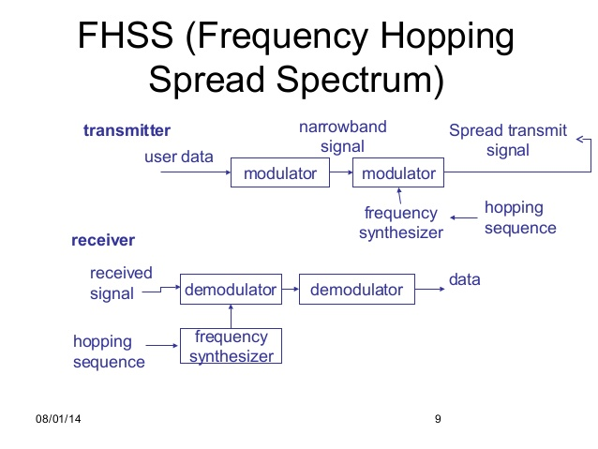
Block Diagram

Slide 11
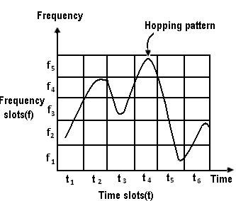

Slide 12
2) Direct Sequence Spread Spectrum(DS-SS): In this, can be used in practice for transmission of signal over a bandpass channel (ex-satellite channel)
Uses two major signaling techniques PSK (phase shift keying) DSSS & FSK (frequency shift key) FHSS.
Every user assigned a spreading code. This secret code is used to encode he signal.
This code is multiplied with the original message and resultant message s than transmitted.
Receiver use same spreading code to decode the message o retrieve original message.

Slide 13
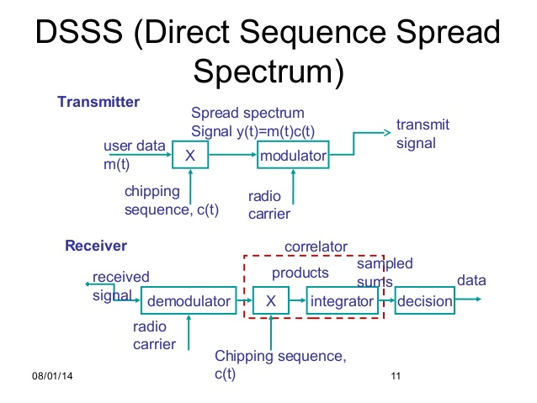
Block Diagram
Block Bloc

Slide 14
